Slide 1
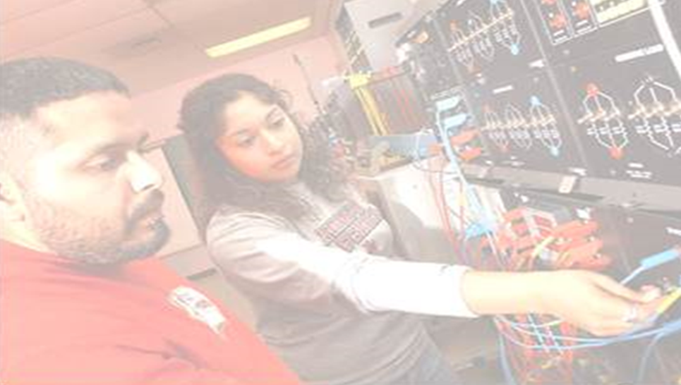
Klipsch School of Electrical and Computer Engineering
E C E
N W MEXI O STATE UNIV RSITY
NWMEXIO STATE UNIVRSITY
E C E
NGINEERING OLLEG
Notes:
We look at physical layer approach to information-theoretic security in wireless communication systems. Secret key encryption scheme is employed using state-of-the-art error correcting codes defined on sparse graphs (fig 1). Nested schemes are employed in multi-terminal networked settings to achieve near capacity performance (fig 2).

Slide 2
Vision
The Klipsch School BSEE will be the regional program of choice; Klipsch School research and graduate programs will be nationally recognized for fundamental and applied contributions.
Mission
The Klipsch School of Electrical and Computer Engineering is dedicated to serving the needs of the people of New Mexico through the land grant mission of New Mexico State University […through Education, Research and Outreach and Public Service].

Slide 3
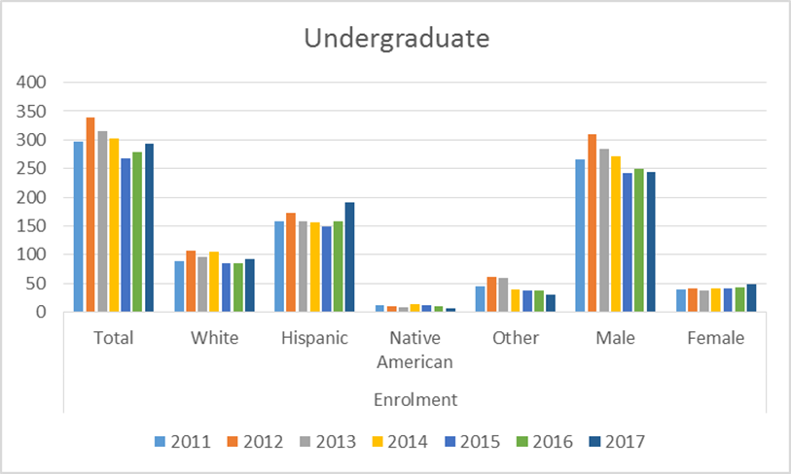
Profile
20 Faculty
3 Adjunct Faculty
4 Post-docs
12 Affiliated
5 Professorships, 2 Chairs
293 UG
  ~180 University/Lottery Scholarships
  ~90 ECE/EE Scholarships +14 aides
69 MS + 46 PhD
  30+ TA
  30 RA+ 2 NASA+ 2 NMC+ Sandia Doctoral
  7 EUMP Fellows
  6 Supplements (Arthur, Grad. School)

Slide 4
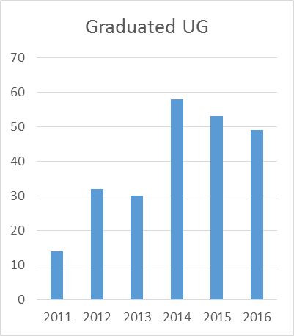
Profile
20 Faculty
3 Adjunct Faculty
4 Post-docs
12 Affiliated
5 Professorships, 2 Chairs
293 UG
  ~180 University/Lottery Scholarships
  ~90 ECE/EE Scholarships +14 aides
69 MS + 46 PhD
  30+ TA
  30 RA+ 2 NASA+ 2 NMC+ Sandia Doctoral
  7 EUMP Fellows
  6 Supplements (Arthur, Grad. School)

Slide 5
Undergraduate Program
120 Cr. BSEE rolled out Fall 2016
Drivers: State, NMSU, Peers
Program
  General Education 43 cr
  Program Specific 117 cr
Highlights
  Lab-based
  ECE Electives – Concentrations
  Cornerstone(Junior) and Capstone(Senior)
  STEM Electives+OOP

Slide 6
Undergraduate Program
Fall 2016
EE100
IAG, ECEA
Students
Spring 2017
EE112
120 Cr. BSEE rolled out Fall 2016
Drivers: State, NMSU, Peers
Program
  General Education 43 cr
  Program Specific 117 cr
Highlights
  Lab-based
  – Concentrations
  Cornerstone(Junior) and Capstone(Senior)
  STEM Electives+OOP
Fall 2017
EE230, EE212
IAG, ECEA
Students
Alumni Survey
Group Meetings
De Leon
IAG, ECEA
Students
Final Report
Faculty Approval
Inform ABET

Slide 7
Undergraduate Program
Fall 2016
EE100
120 Cr. BSEE rolled out Fall 2016
Drivers: State, NMSU, Peers
Program
  General Education 43 cr
  Program Specific 117 cr
Highlights
  Lab-based
  – Concentrations
  Cornerstone(Junior) and Capstone(Senior)
  STEM Electives+OOP
Spring 2017
EE112
IAG, ECEA,Students
Fall 2017
EE212, Design Concentrations
Fall 2018
Cornerstone

Slide 8
Undergraduate Program
Circuits and Computers
Required (4 cr each):
EE 363 Computer Systems Architecture (VHDL)
EE 480 Introduction to VLSI
Choose one (3 cr each):
EE 443 Mobile Application Development EE 483 RF Microelectronics
EE 469 Communications Networks EE 485 Analog VLSI Design
EE 482 Electronics II EE 486 Digital VLSI Design
Circuits and Computers
Communications and Signal Processing
Electromagnetics and Photonics
Power and Control
Space
None

Slide 9
Undergraduate Program
Circuits and Computers
Communications and Signal Processing
Electromagnetics and Photonics
Power and Control
Space
None

Slide 10
Graduate Program
MSEE 30 Credits
  Thesis, Report or coursework only
  ~ 10 classes – distance. Hybrid mode.
Certificates 12 credits
  Energy, Telemetry, DSP
Eagerly await ME degree
PhD 18 credits+dissertation after MS
  Several off-site PhD students (Sandia, ADF/SW)

Slide 11
Destinations
  Landys and Gyr El Paso Electric Freeport-McMoran US Arny(Civ) Intel WSMR Sandia Graduate School, NMSU Notre Dame Rice SMU Nav Air
  APL T&D Services Ethicon Palo Verde Nuclear Generating Station, AZ
  WSMR Raytheon General Dynamics JPL Honeywell HDR Engineers PNM
  ETA Wireless IBM Austin StartFast Venture Accelerator & StartFast Code
  Post Doc Los Alamos NMSU Post Doc Intelligent Automation Inc. Al Ahliyya Amman University Instituto Tecnológico y de Estudios Superiores de Monterrey Ford Motor Co.(Autonomous Vehicles) NASA Raytheon

Slide 12
Special Programs
  Electric Utility Management Program
  Funded by utility industry
  Tuition Support and Stipend for MS
  Can support RA/PhD
  PNM Chair funds add student support
  Frank Carden Telemetering Chair/ Telemetering Professorship
  Assists Telemetering Foundation with ITC
  Student scholarships – must attend/present at ITC
  Some student support
  Some infrastructure support

Slide 13
Research Interests/Expertise
Sensors/Processing/Remote Sensing
-Tang, Boucheron, Stochaj, Dawood
Smartgrid/Renewables
-Ranade, Brahma, Prasad, Mitchell, Cao, Boucheron, Tran, Pontelli, Misra, Kavasseri
Space
-Stochaj, Boucheron, Borah, Voelz, Cho, Chanover, McAteer, Jackiewicz,
Big Data /Deep Learning
-Boucheron, Creusere, Brahma, De Leon, Cao, Tran. Pontelli
Education
-Stochaj, Boucheron, Dawood, Houston, Mitchell, Sullivan, Brown, Trujillo
Ultra low power VLSI – Analog, Mixed,
-Tang, Ramirez, Furth, Creusere,
Communications/Wireless/Security
-Borah, Mitchell, Dawood Boucheron, Creusere, Voelz, Cho Kliewer, Kroger
Photonics – Systems/Materials
-Cho, Voelz, Stochaj, Chanover

Slide 14
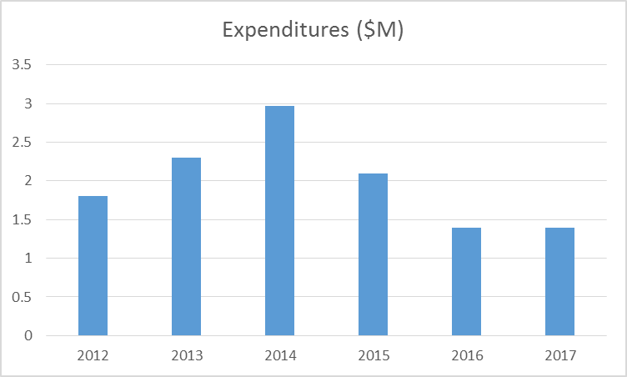
Research Highlights/Expenditures
2012-2014 New faculty ramp up
~2014 - 3 productive faculty left
2016-17 Newly hired faculty getting grants
Tang NSF Career
Badawy NSF/ AHPRC/ Los Alamos
De Leon /Sandoval Sandia
Mitchell NSF
Boucheron/Stochaj NSF
Dawood NSF
Brahma SNL/ DOE
Ranade SNL/ DOE
Cho/Voelz DOD/ARL
~ $100K /faculty

Slide 15
The future –
Our degrees are the programs of choice
Research contributions will be well recognized
Industry/peers will seek us out for collaborations

Slide 16
The future – 3 years
Undergraduate
    Grow enrolment to 350
      Aggressive recruiting
      Student engagement
      Retention Strategies
    Solidify Lower Division curriculum
      “ All ECEs should be experts at myarea…” v. “What every ECE should know about xyz…”
    Use cornerstone to introduce
      broad, integrative thinking
      entrepreneurship, business thinking
    Make electives system very flexible
    Emphasize internships
    Support the Teacher
Graduate
    Grow enrolment to 120 (30 MS, 50 PhD, 40 ME/DE)
    Quality over Quantity
    Emphasize scholarship
    Purposefully market ME
    MS/PhD only with full funding including tuition support
      Endow Fellowships
      Grow funded research
    Invest in Post -docs
  Our capacity is estimated at 450 UG, 75 Phd/MS(research)
  Constrained by space, TA funds

Slide 17
The future – 3 years
Research Enterprise
  Quality over Quantity
  Visibility
    College efforts
    Attendance, Leadership in flagship conferences
    Editorial Boards, Committees
    Invited Seminars, bidirectional
    Bi-annual email with good news
  Support the Researcher
    Workload
    Grading support
    Graduate Recruiting
    Travel
    Seed funds
  We could get back to $3M expenditures
  Singular constraint is recruiting

